Slide 1
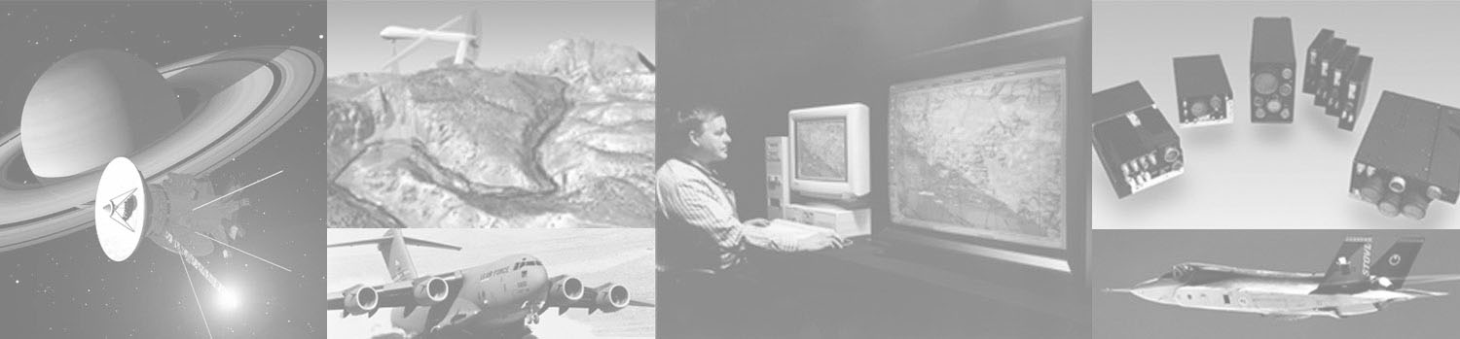
ELDP Software Development Week 2
Week 2 – SW Design
SW Technologists– 2/6/2008

Slide 2
Week 2 Description
Software Design at BAE Systems
  MDP 12.0
  SWP180-SWP183
  Application Software Design
  Embedded Software Design
Introduction to Object Oriented Programming
  Classes, Objects, Class Diagrams
  Inheritance, Polymorphism, Encapsulation, Abstraction
  Design Example: Social Networking Site
  Develop some Use Cases for Basic IR countermeasure controller

Slide 3
Week 2 Description
Basic Design Patterns
  Basic GoF patterns like singleton, factory, adapter
  Factory Method vs. Factory Pattern
  Publish-Subscribe (Observer)
  Command
  Decorator
  Do a design case study… show multiple designs for some functionality of the example software from above and discuss its benefits/drawbacks.
More advanced patterns
  Proxy
  Flyweight
  Chain of Responsibility

Slide 4
Software Design at BAE Systems
MDP 12.0 Engineering Process Control
  Type A – IPDP Framework (A12021)
  Type B – Engineering Process Document (8830107)
  Type C – Legacy NES Integrated Product Lifecycle
E&IS Policy 5601 – Common Engineering Process
  5601.02 – Independent Design Reviews
  Design Maturity Assessment Handbook
  Independent Design Review Plan Template
  Design Maturity Assessment Workbook Template
Notes:
Type A:
“All engineering product development will be performed in accordance with the IPDP Framework (A13021) and MDP 11.0, Project Planing and Execution.” – MDP 12.0
“The E&IS Engineering Policy 56xx directs the use of the E&IS Common Engineering Processes such as the Independent Design Review Procedure. These common processes are used directly rather than being incorporated into IPDP.” –IPDP Framework
“Product development projects shall support independent design reviews and phase reviews in accordance with BAE Systems, Inc. policy, as documented in each project’s specific process.” – IPDP Policy
“Product development projects shall design, develop, and implement solutions based on analysis of customer and product requirements, in accordance with the project’s specific process.” --IPDP Policy – Technical section
IPDP Specifies review processes in Section 3.3.8.2.2 Stakeholder Reviews
Type B:
Engineering Process Document dictates the Top Level Process for Software Engineering in section 3.1.2 and Design Review Checklists in section 7.1.1.1
Type C:
“For Legacy NES, all engineering product development and support will be performed in accordance with the Legacy NES Integrated Product Lifecycle (IPL) (EN-10269-PCO), and MDP 11.0, Project Planning and Execution.” -- MDP 12.0
5601.02 lays out the design plan process and how to plan design reviews.
5601.02.TM1 – Independent Design Review Plan Template
5601.02.TM2 – Design Review Record Template
5601.02.TM3 – Design Maturity Assessment Workbook Template

Slide 5
Software Design at BAE Systems
SWP180 – Software Design
  Describes the steps to perform software design. Includes preliminary design and detailed design.
  Section 4 describes the Design Planning and Preparation roles.
  Section 5 describes the appropriate outputs.
SWP181 – Detailed Design
  Describes Peer Review entry conditions and Review points,

Slide 6
Software Design at BAE Systems
SWP182 – Design Work Products – Structured
  M-Specs, Context Diagrams, Data Dictionary, Data Flow Diagrams, P-Specs, Decision Tables, Process Activation Tables, State Transition Diagrams, State/Event Matrices, Entity Relationship Diagrams, Event Response Matrices
SWP183 – Design Work Products – Object Oriented
  Use Case Diagrams, Class/Object Diagrams, State Diagrams, Activity Diagrams, Package Diagrams, Interaction Diagrams (Sequence or Collaboration)

Slide 7
Software Design at BAE Systems
Application Software Design
  Developing of software for non-embedded systems. Pre-flight message generators, ground simulation, lab simulation, data managers, network application software, SOA services, etc.
Embedded Software Design
  Software that will live “in a box”
  Software designed “in house” for deployed hardware
  Software that considers timing, power, and space requirements
  Affected by processor speed, memory size and configuration, communication hardware interfaces, etc.

Slide 8


What is UML?
Introduction to Object Oriented Programming
Unified Modeling Language
  Not a programming language like C, C++, or Java
  Industry Standard for specifying, visualizing, constructing, and documenting Object-Oriented Programs
  Endorsed by the Object Management Group
    http://www.omg.org
    http://www.uml.org/
  The OMG supports several versions of UML.
    The current version is UML 2.0.
Notes:
Sample text slide with imagery
Copyright © 2005 BAE Systems. All rights reserved.

Slide 9
Introduction to Object Oriented Programming
UML– Object Management Group (OMG)
  Booch, Rumbaugh, and Jacobson (Three Amigos)
  Submitted and adopted in 1997
  Three different views:
    Functional requirements view
    Static structural view
    Dynamic Behavior view
Notes:
Functional Requirements view – emphasizes the functional requirements of the system from the user’s point of view. Use Case Diagrams
Static Structural view – Emphasizes the static structure of the system using objects, attributes, operations, and relationships. Class Diagrams and Composite Structure Diagrams.
Dynamic Behavior view – Emphasizes the dynamic behavior of the system by showing collaborations among objects and changes to the internal states of objects. Sequence Diagrams, Activity Diagrams, and State Machine Diagrams

Slide 10
Introduction to Object Oriented Programming
UML 2.0 – Object Management Group (OMG)
  Superstructure adopted in 2004
  Specification declared available and added to OMG library
  Infrastructure, Diagram Interchange, and OCL adopted
  Resolved Semantic Integration
  Ports
  Sequence Diagrams
  Information Flows
  Structured Classes
  State machine Inheritance
  Activity Diagram Enhancements
Concentration on timing requirements, space, resources
Notes:
Ports – A port is a property of a classifier that specifies a distinct interaction point between that classifier and its environment or between the (behavior of the) classifier and its internal parts. Ports are connected to properties of the classifier by connectors through which requests can be made to invoke the behavioral features of a classifier. A Port may specify the services a classifier provides (offers) to its environment as well as the services that a classifier expects (requires) of its environment.
Sequence Diagrams – Enhancements in UML 2.0 were made for large system scalability. The two main enhancements were in the addition of interaction occurrences to describe how a particular sequence of events occurs through operators and the second addition was lifeline decomposition. Lifeline decomposition is the ability to decompose a piece of the system into parts, making it easier for designer to drill down from the top level of the system down to finer levels of granularity.
Information Flows – A systems engineering enhancement to UML 2.0, Information Flow, provides mechanisms for specifying the exchange of information between entities of a system at a high level of abstraction. Information flows describe circulation of information in a system in a general manner. They do not specify the nature of the information (type, initial value), nor the mechanisms by which this information is conveyed (message passing, signal, common data store, parameter of operation, etc.). They also do not specify sequences or any control conditions. It is intended that, while modeling in detail, representation and realization links will be able to specify which model element implements the specified information flow, and how the information will be conveyed.
Structured Classes – These were added so that larger pieces of the system such as components or subsystems can be easily broken down into more manageable parts through decomposition. Extends the metaclass Class with the capability to have an internal structure and ports. A class acts as the namespace fro various kinds of classifiers defined within its scope, including classes. Nesting of classifiers limits the visibility of the classifier to within the scope of the namespace of the containing class and is used for reasons of information hiding. Nested classifiers are used like any other classifer in the containing class.
State Machine Inheritance – This was added to reuse state machine behavior through generalization, so that more complex behaviors can be captured for more complex systems. This is also very useful for simpler systems to allow the reuse of simple behaviors that can be expanded in a variety of ways with Statechart notations.
Activity Diagram enhancements – UML 2.0 Activity Diagrams are useful to model system level behavior of use cases and other system components (subsystems, components, classes). Activity Diagrams are similar to flow charts and data flow diagrams of structured methods.

Slide 11


Use Cases – Preliminary Design
Introduction to Object Oriented Programming
Purpose
  Represent the functionality of the system from a user’s point of view
  Define the boundaries of the system
  Often are a basis for high-level requirements
Terminology
  Actors are external entities that interact with the system
  Subject is the system under construction to which the use case applies
  Use cases describe the behavior of the system as seen from an actor’s point of view
Either a diagram or a written depiction (scenario)

Slide 12
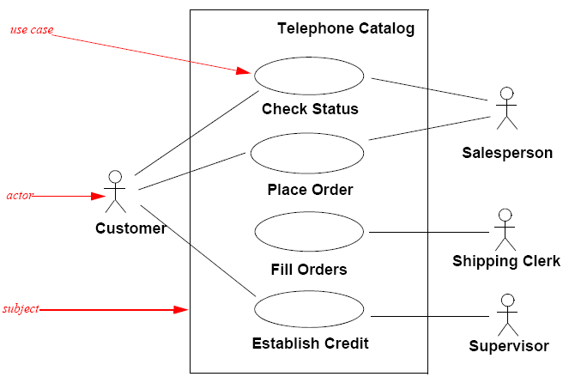
Use Case Example (Diagram)
Introduction to Object Oriented Programming

Slide 13
Use Case Instance (Scenario)
Introduction to Object Oriented Programming
Use case name Place Order
Participating actor Invoked by Customer
Communicates with Sales Person
Entry condition 1. The Customer places a call into the Telephone Catalogue.
Flow of Events 2. The call is routed to the Sales Person via the Telephone
Catalogue.
3. The Customer communicates the desired Part No. to the Sales Person.
4. The Customer communicates his/her billing and shipping information to the Sales Person.
5. The Sales person records the given information into the sales database for further processing.
Exit Condition 6. The Sales Person confirms the order with the Customer verbally and electronically through an automated email.
Special Requirements The email is sent within 1 day of the order placement.

Slide 14
Use Case Relationships
Introduction to Object Oriented Programming
Three types of relationships defined in Use Cases:
  Communication
    Indicates a level of communication between actors within a use case
    Depicted by a line between Actor and Use Case
    Note that all use cases should have at least one communication arrow
  Generalization
    Indicates that one actor inherits from another actor
    Depicted by an open blocked arrow from super-class to sub-class
  Inclusion
    Indicates that a use case contains the behavior defined in another use case.
    Depicted by a dashed arrow with an open arrowhead from the base use case to the included use case. The arrow is labeled with the keyword «include»
  Extension
    Indicates that a use case provides additional behavior over another use case, typically when certain conditions are met
    Depicted by a dashed arrow with an open arrowhead from the use case providing the extension to the base use case. The arrow is labeled with the keyword «extend».
    The condition of the relationship as well as the references to the extension points are optionally shown in a Note attached to the corresponding extend relationship.

Slide 15
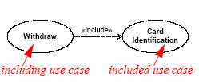

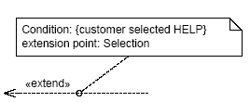
Use Case Example
Introduction to Object Oriented Programming
Inclusion
Generalization
Extension
Selection
Help
Selection
extended use case
extending use case

Slide 16
Introduction to Object Oriented Programming
Detailed Design - Classes and Objects
Terminology
  Classes are abstractions that specify the attributes and behavior of a set of objects
    e.g. Button, Collection, Thread
  Objects are entities that encapsulate state and behavior. They are instances of classes
    e.g. Button1, Button2, PlusMinusButton
  It’s the difference between a data type and variables of that data type

Slide 17
Introduction to Object Oriented Programming
Class Diagrams
A class describes a set of objects that share the same specifications of features, constraints, and semantics.
  In other words, what objects exist in our system, and how do they relate
A Class has two major features:
  Attributes
    Define the data that an object encapsulates
  Methods (operations)
    Defines the behavior of an object

Slide 18
Introduction to Object Oriented Programming
Class Relationships
Classes form three types of relationships with other classes
  Generalization
    Relationships between a general class and one or more specialized class. A specialized class is said to inherit from a generalized class.
    Known as the “is-a” relationship
  Association
    Defines a relationship between instances of the two classes.
  Aggregation
    An association denoting a whole part relationship between two classes

Slide 19
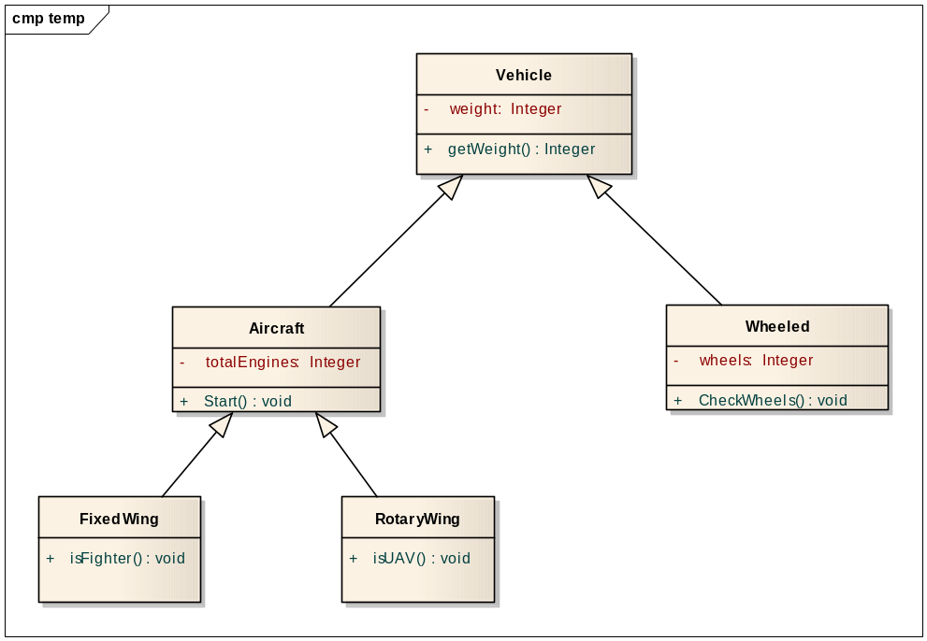
Introduction to Object Oriented Programming
  Inheritance – Inheritance allows a class to inherit the attributes and methods of another class. This allows you to create brand new classes by abstracting out common attributes and behaviors.

Slide 20
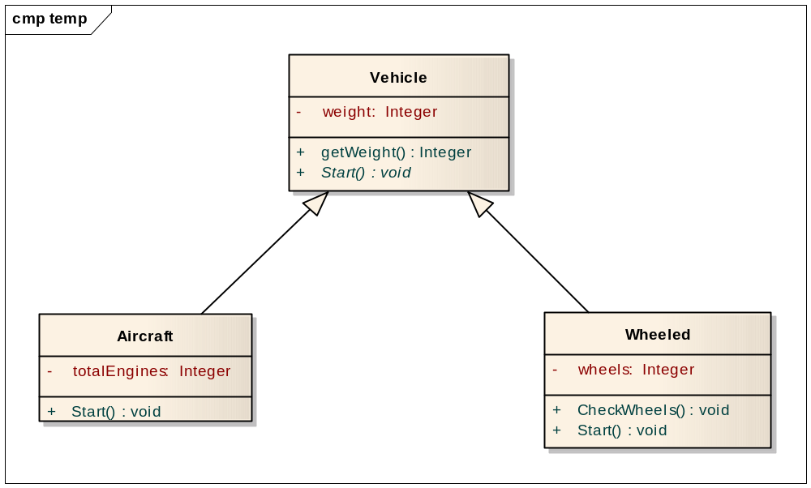
Introduction to Object Oriented Programming
Polymorphism – Allows you to treat derived class members like their parent class’ memebers. In this case, the Start() method is virtual in the Vehicle class.

Slide 21
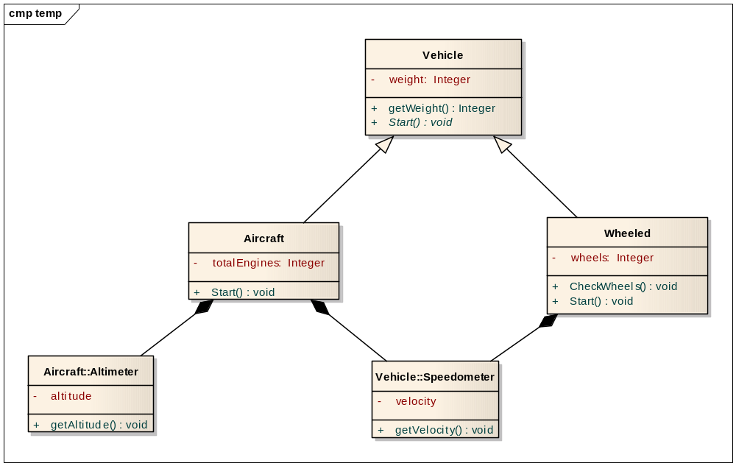
Introduction to Object Oriented Programming
Abstraction – Achieved through Composition. A class can be defined by the sum of it’s parts.

Slide 22
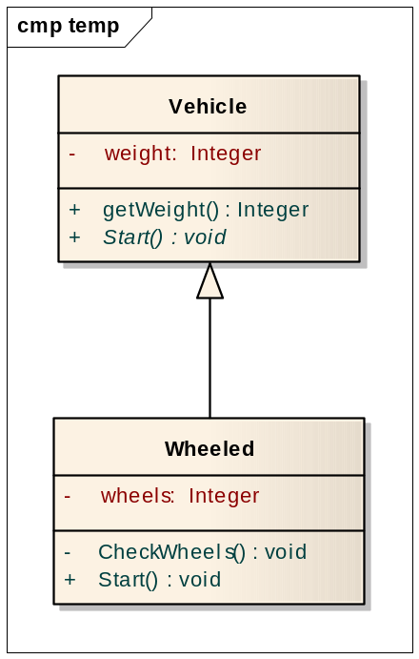
Introduction to Object Oriented Programming
Encapsulation – conceals the functional details of a class that sends messages to it. This is achieved by specifying that methods and attributes are public, private, or protected.

Slide 23
Sequence Diagrams
Sequence diagrams are most useful when you want to look at the behavior of several objects within a single use case
Show how objects interact in relation to time and each other
A typical sequence diagram consists of:
  N number of objects displayed across the x-axis
  Time is represented along the y-axis (from top to bottom)
  Each object has dotted-line along the y-axis denoting its object lifetime
  Method invocations, or message passing, are denoted by directed lines from one class to another
    Each line is labeled, denoting the specific method or message being passed

Slide 24
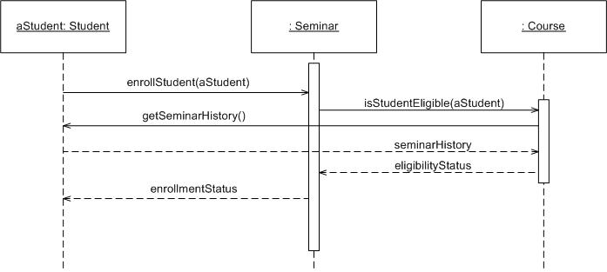
Sequence Diagram Example
Source: http://www.agilemodeling.com

Slide 25
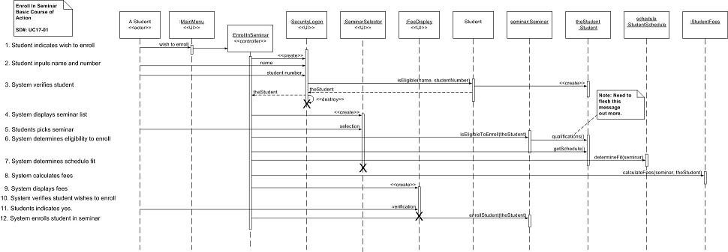
Sequence Diagram Example
Source: http://www.agilemodeling.com

Slide 26
Introduction to Object Oriented Programming
Case Study – Social Networking application
  Design an OO model of a software system to implement requirements by creating a set of use cases. Use cases should consist of Actor, Inputs, Outputs, Pre-conditions, and Post-Conditions.
  Diagram use cases
  Develop a simple class diagram for a User Account object.
  Generate Sequence diagrams indicating the flow of method calls within the system.
  There is no perfect model. Do not attempt to find all Use Cases. Do not attempt to find all method calls.

Slide 27
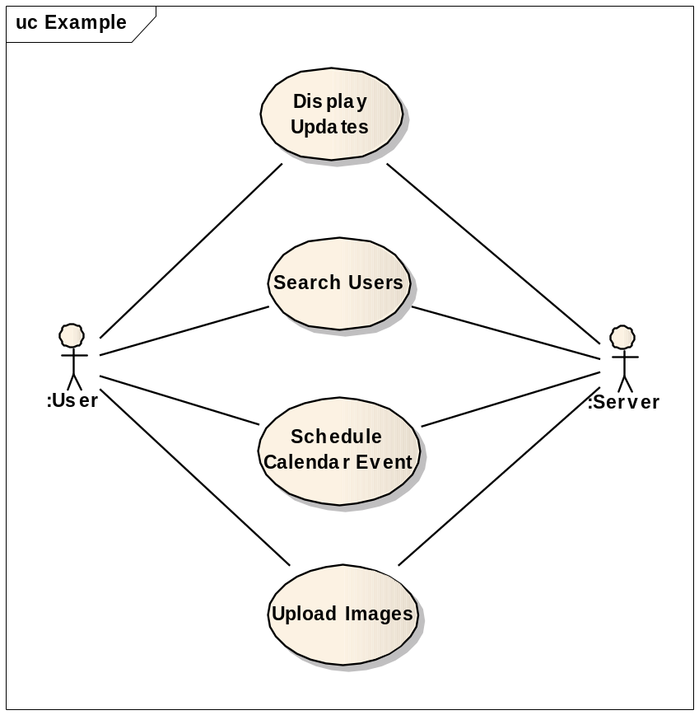
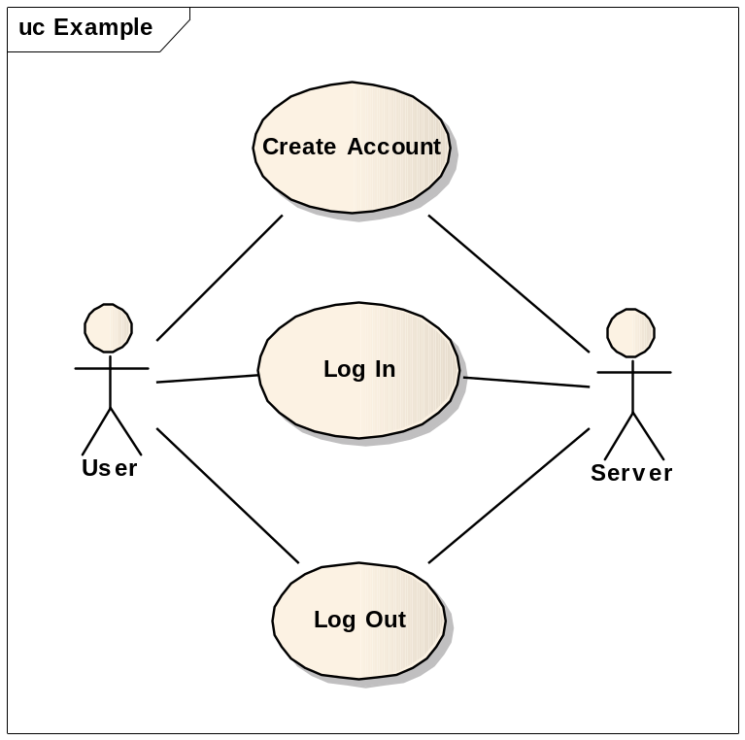
Introduction to Object Oriented Programming

Slide 28
Basic Design Patterns
  Singleton
  Factory
  Adapter
  (Abstract) Factory Pattern
  Factory Method
  Publish-Subscribe (Observer)
  Command
  Decorator

Slide 29
Basic Design Patterns
Singleton Pattern – Ensures the class has only one instance, and provides a global point of access to it.
Singleton
Static Instance()
SingletonOperation()
GetSingletonData()
return uniqueInstance
Static uniqueInstance
singletonData

Slide 30
Basic Design Patterns
Factory Pattern – Could mean Abstract Factory Pattern or Factory Method.
Abstract Factory – Provides an interface for creating families of related or dependent objects without specifying their concrete classes.
  Use when a system should be independent of how its products are created, composed, and represented.
  Use when a system should be configured with one of multiple families of products.
  Use when a family of related product objects is designed to be used together, and you need to enforce this constraint.
  Use when you want to provide a class library of products, and you want to reveal just their interfaces, not their implementations.

Slide 31
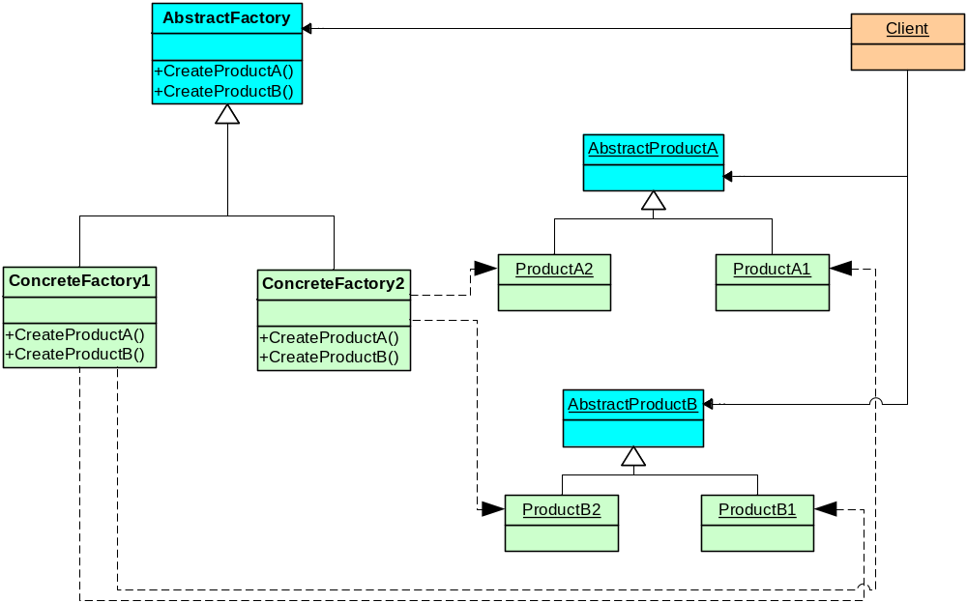
Factory Pattern

Slide 32
Basic Design Patterns
Factory Method – Defines an interface for creating an object, but lets subclasses decide which class to instantiate. Factory Method lets a class defer instantiation to subclasses.
  Use when a class can’t anticipate the class of objects it must create
  Use when a class wants its subclasses to specify the objects it creates
  Use when classes delegate responsibility to one of several helper subclasses, and you want to localize the knowledge of which helper subclass is the delegate.

Slide 33
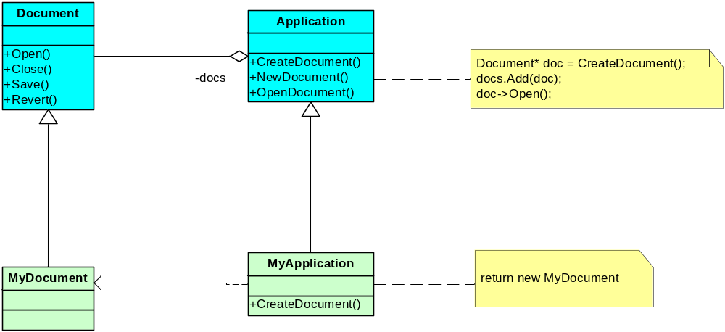
Factory Method (Virtual Constructor)

Slide 34
Adapter Pattern
Convert the interface of a class into another interface clients expect. Adapter lets classes work together that couldn’t otherwise because of incompatible interfaces.
  Use when you want to use an existing class, and its interface does not match the one you need.
  Use when you want to create a reusable class that cooperates with unrelated or unforeseen classes, that is, classes that don’t necessarily have compatible interfaces.
  (Object Adapter Only) Use when you need to use several existing subclasses, but it’s impractical to adapt their interface by subclassing every one. An object adapter can adapt the interface of its parent class.

Slide 35
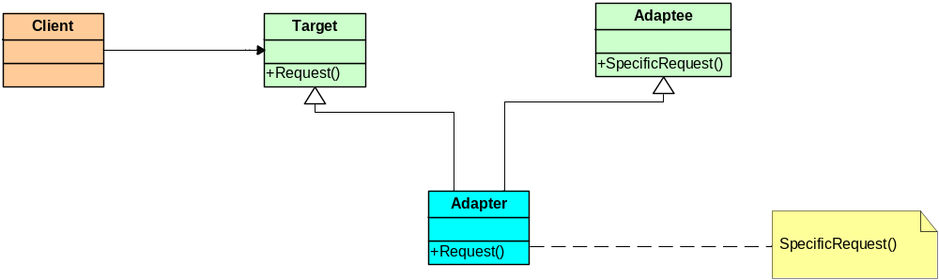
Adapter Pattern

Slide 36
Observer Pattern
Define a one-to-many dependency between objects so that when one object changes state, all its dependents are notified and updated automatically.
  Use when an abstraction has two aspects, one dependent on the other. Encapsulating these aspects in separate objects lets you vary and reuse them independently.
  Use when a change to one object requires changing others, and you don’t know how many objects need to be changed.
  When an object should be able to notify other objects without making assumptions about who these objects are. In other words, you don’t want these objects tightly coupled.

Slide 37
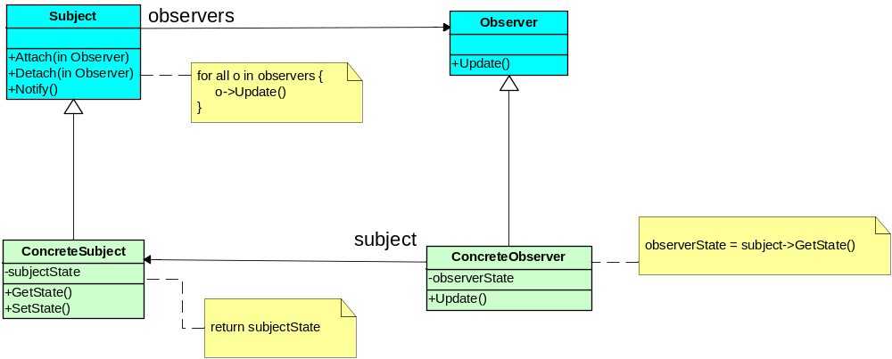
Observer Pattern

Slide 38
Command Pattern
Encapsulate a request as an object, thereby letting you parameterize clients with different requests, queue or log requests, and support undoable operations.
  Use when you want to parameterize objects by an action to perform. You can express such parameterization in a procedural language with a callback function, that is a function that’s registered somewhere to be called at a later point. Commands are an object-oriented replacement for callbacks.
  Use when you want to specify, queue, and execute requests at different times. A Command object can have a lifetime independent of the original request. If the receiver of a request can be represented in a n address space-independent way, then you can transfer a command object for the request to a different process and fulfill the request there.

Slide 39
Command Pattern
  Use when you want to support undo. The Command’s Execute operation can store state for reversing its effects in the command itself. The Command interface must have an added Unexecute operation that reverses the effects of a previous call to Executed commands are stored in a history list. Unlimited-level undo and redo is achieved by traversing this list backwards and forwards calling Unexecute and Execute, respectively.
  Use when you want to support logging changes so that they can be reapplied in case of a system crash. By augmenting the Command interface with load and store operations, you can keep a persistent log of changes. Recovering from a crash involves reloading logged commands from disk and re-executing them with the Execute operation.
  Use when you want to structure a system around high-level operations built on primitives operations. Such a structure is common in information systems that support transactions. A transaction encapsulates a set of changes to data. The Command pattern offers a way to model transactions. Commands have a common interface, letting you invoke all transactions the same way. The pattern also makes it easy to extend the system with new transactions.

Slide 40
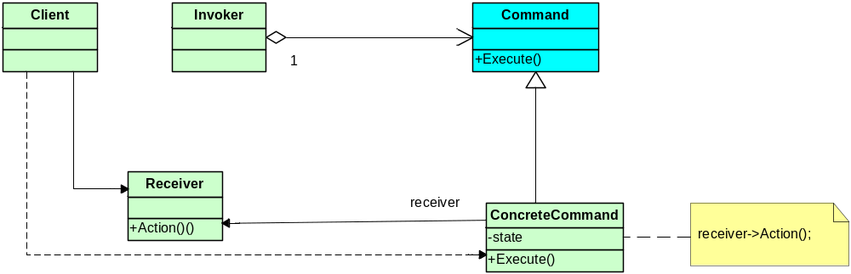
Command Pattern

Slide 41
Decorator Pattern
Attach additional responsibilities to an object dynamically. Decorators provide a flexible alternative to sub-classing for extending functionality.
  Use to add responsibilities to individual objects dynamically and transparently, that is, without affecting other objects.
  Use for responsibilities that can be withdrawn.
  Use when extension by sub-classing is impractical. Sometimes a large number of independent extensions are possible and would produce an explosion of subclasses to support every combination. Or a class definition may be hidden or otherwise unavailable for sub-classing.

Slide 42
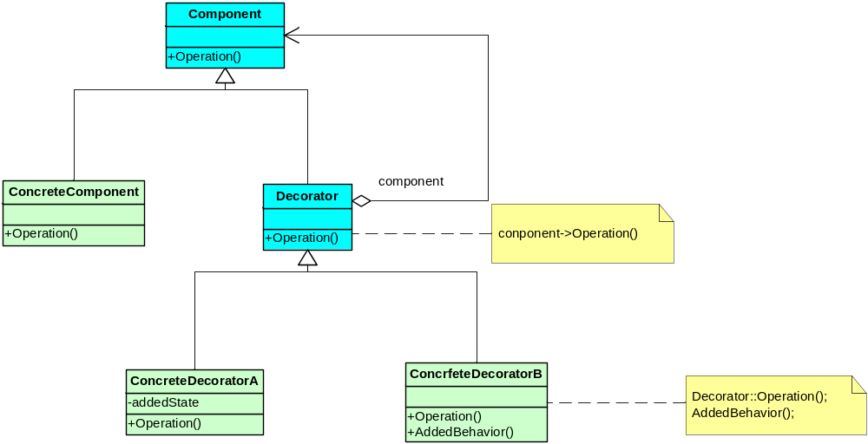
Decorator Pattern

Slide 43
Basic Design Patterns
Additional GoF Basic Patterns
  Builder
  Prototype
  Bridge
  Composite
  Façade
  Interpreter
  Iterator
  Mediator
  Memento
  State
  Strategy
  Template Method
  Visitor

Slide 44
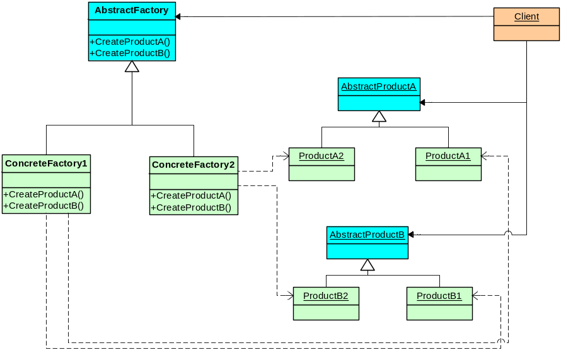
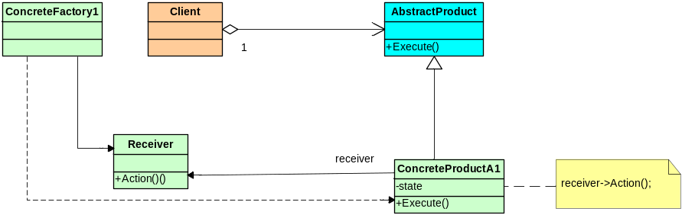
Case Study
Abstract Factory Pattern
Command Pattern

Slide 45
Case Study
Benefits
  Client has been decoupled from both the generator (Factory) and the messages (command objects). This isolates the concrete classes.
  Makes exchanging product families easy. All of the command objects are generated in the factory. If you need a different set of command objects, you simply change the factory. The client is decoupled from all of this.
  You gain all of the benefits of the Abstract Factory along with the benefits of the Command pattern.
Drawbacks
  Each command object must have knowledge of it’s capabilities. In order for a command object to execute properly, it must be able to access all resources required for execution. This can affect uniformity between command objects if not well designed.
  If one factory interface is changed, all factory interfaces must be changed to maintain compatibility. The same goes for Command objects.

Slide 46
More Advanced Patterns
  Proxy
  Flyweight
  Chain of Responsibility

Slide 47
Proxy Pattern
Encapsulate a request as an object, thereby letting you parameterize clients with different requests, queue or log requests, and support undoable operations.
  Use when you want to parameterize objects by an action to perform. You can express such parameterization in a procedural language with a callback function, that is a function that’s registered somewhere to be called at a later point. Commands are an object-oriented replacement for callbacks.
  Use when you want to specify, queue, and execute requests at different times. A Command object can have a lifetime independent of the original request. If the receiver of a request can be represented in a n address space-independent way, then you can transfer a command object for the request to a different process and fulfill the request there.

Slide 48
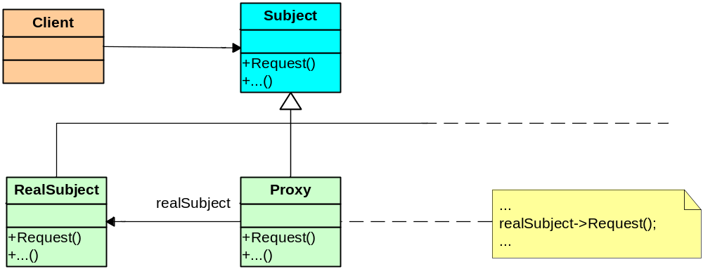
Proxy Pattern

Slide 49
Flyweight Pattern
Use sharing to support large numbers of fine-grained objects efficiently. Must follow all cases listed.
  Use when an application uses a large number of objects.
  Use when storage costs are high because of the sheer quantity of objects.
  Use when most object state can be made extrinsic. (depends on and varies with the flyweight’s context and cannot be shared)
  Use when many groups of objects may be replaced by relatively few shared objects once extrinsic state is removed.
  The application doesn’t depend on object identity. Since flyweight objects may be shared, identity tests will return true for conceptually distinct objects.

Slide 50
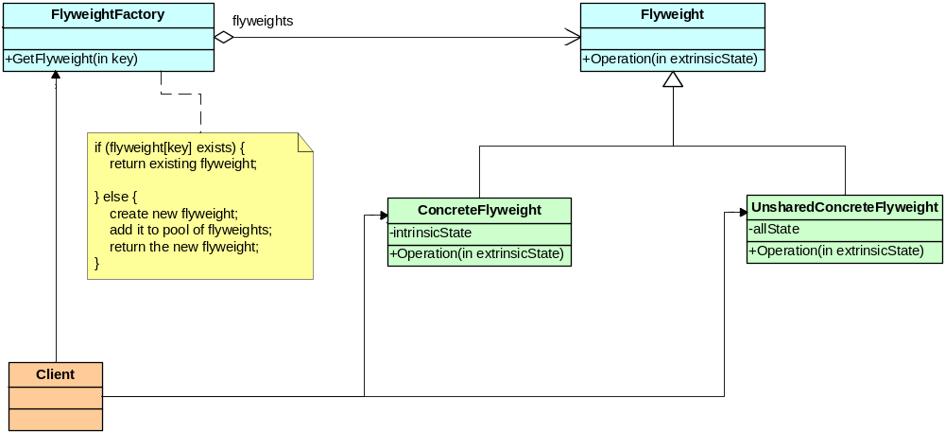
Flyweight Pattern

Slide 51
Chain of Responsibility Pattern
Avoid coupling the sender of a request to its receiver by giving more than one object a chance to handle the request. Chain the receiving objects and pass the request along the chain until an object handles it.
  Use when more than one object may handle a request, and the handler isn’t known a priori. The handler should be ascertained automatically.
  Use when you want to issue a request to one of several objects without specifying the receiver explicitly.
  Use when the set of objects that can handle a request should be specified dynamically.

Slide 52
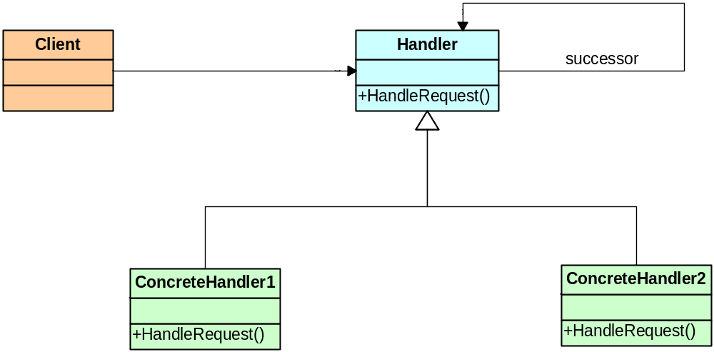
Chain of Responsibility Pattern

Slide 53
Week 2 Suggested Reading
Gamma, Helm, Johnson, Vlissides, Design Patterns, ©1995 Addison-Wesley
Fowler, Refactoring, ©1999 Addison-Wesley
Freeman & Freeman, Head First Design Patterns, ©2004 O’Reilly Media, Inc.

